Slide 1


<C. Hsu>
<25 March 2023>

Slide 2

Outline
Executive Summary
Introduction
Methodology
Results
Conclusion
Appendix

Slide 3
Executive Summary
Summary of methodologies
Summary of all results

Slide 4
Introduction
Project background and context
Problems you want to find answers

Slide 5

Section 1

Slide 6
Methodology
Executive Summary
Data collection methodology:
Data was collected directly from <https://api.spacexdata.com/v4/launches/past>
Perform data wrangling
The json response the URL was first converted to a Pandas dataframe using .json_normalize() and items of interests are then extracted into an abridged dataframe
Perform exploratory data analysis (EDA) using visualization and SQL
Perform interactive visual analytics using Folium and Plotly Dash
Perform predictive analysis using classification models
How to build, tune, evaluate classification models

Slide 7
Data Collection
Data sets were requested through WEB services REST API from URL as response = requests.get("https://api.spacexdata.com/v4/launches/past") (back-up copy was prepared for the capstone project at 'https://cf-courses-data.s3.us.cloud-object-storage.appdomain.cloud/IBM-DS0321EN-SkillsNetwork/datasets/API_call_spacex_api.json‘)
The retrieved content in JSON format are converted into Pandas dataframe to facilitate data processing using .json_normalize() as data = pd.json_normalize(response.json())
From this data object only items of interests separately defined in a dictionary list launch_dict are extracted to simplify processing as dataframe = pd.DataFrame.from_dict(launch_dict)
Filter the dataframe to keep all Falcon 9 launches into dataframe data_falcon9 data_falcon9 = dataframe[dataframe['BoosterVersion'] != 'Falcon 1']

Slide 8
Data Collection – SpaceX API
data collection with SpaceX REST calls and flowcharts are as shown:
GitHub repository of the completed SpaceX API calls notebook (including complete code cells and outcome cells) posted at the following URL
response = requests.get("https://api.spacexdata.com/v4/launches/past")
data = pd.json_normalize(response.json())
dataframe = pd.DataFrame.from_dict(launch_dict)
data_falcon9 = dataframe[dataframe['BoosterVersion'] != 'Falcon 1']
convert to dataframe
prepare item list
get URL
select records of Falcon 9 boosters only into new dataframe
extract item list into new dataframe
https://github.com/a220100/worksheets/blob/e64688f6407759ff2292bedc9329cddd718742c7/jupyter-labs-spacex-data-collection-api.ipynb

Slide 9
Data Collection - Scraping
the web scraping process and its flowchart are as listed below:
response = requests.get("https://en.wikipedia.org/w/index.php?title=List_of_Falcon_9_and_Falcon_Heavy_launches&oldid=1027686922")
soup = BeautifulSoup(response.text, "html.parser")
column_names = []
for th in first_launch_table.find_all("th"):
column_names.append(extract_column_from_header(th))
prepare item list into a dictionary
get URL
extract tables
convert dictionary into a dataframe
extract items from each row of the table
GitHub repository of the completed web scraping notebook is deposited at https://github.com/a220100/worksheets/blob/fe361e4ad51dce63e1da110ae00bc22ea2ea3e37/jupyter-labs-webscraping.ipynb

Slide 10
Data Wrangling
Describe how data were processed
You need to present your data wrangling process using key phrases and flowcharts
GitHub repository of the completed data wrangling notebook is deposited at https://github.com/a220100/worksheets/blob/fe361e4ad51dce63e1da110ae00bc22ea2ea3e37/labs-jupyter-spacex-data_wrangling_jupyterlite.jupyterlite.ipynb

Slide 11
EDA with Data Visualization
Summarize what charts were plotted and why you used those charts
Add the GitHub URL of your completed EDA with data visualization notebook, as an external reference and peer-review purpose
GitHub repository of the completed EDA visualization notebook is deposited at
https://github.com/a220100/worksheets/blob/fe361e4ad51dce63e1da110ae00bc22ea2ea3e37/jupyter-labs-eda-dataviz.ipynb.jupyterlite.ipynb

Slide 12
EDA with SQL
Using bullet point format, summarize the SQL queries you performed
Add the GitHub URL of your completed EDA with SQL notebook, as an external reference and peer-review purpose

Slide 13
Build an Interactive Map with Folium
Summarize what map objects such as markers, circles, lines, etc. you created and added to a folium map
Explain why you added those objects
Add the GitHub URL of your completed interactive map with Folium map, as an external reference and peer-review purpose

Slide 14
Build a Dashboard with Plotly Dash
Summarize what plots/graphs and interactions you have added to a dashboard
Explain why you added those plots and interactions
Add the GitHub URL of your completed Plotly Dash lab, as an external reference and peer-review purpose

Slide 15
Predictive Analysis (Classification)
Summarize how you built, evaluated, improved, and found the best performing classification model
You need present your model development process using key phrases and flowchart
Add the GitHub URL of your completed predictive analysis lab, as an external reference and peer-review purpose

Slide 16
Results
Exploratory data analysis results
Interactive analytics demo in screenshots
Predictive analysis results

Slide 17

Section 2

Slide 18
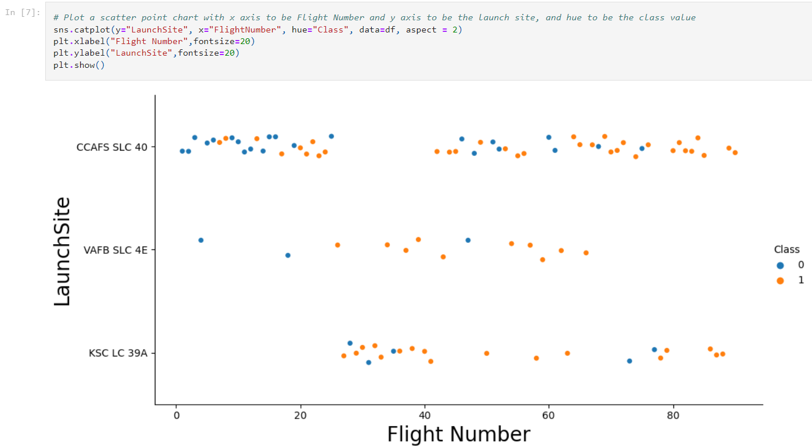
Flight Number vs. Launch Site
scatter plot of Flight Number vs. Launch Site is as shown below
success rates seem to improve with accumulated experiences from more flight launches
the respective flight numbers at each of the launch sites are marked by class-0 (failure) and class-1 (success) accordingly

Slide 19
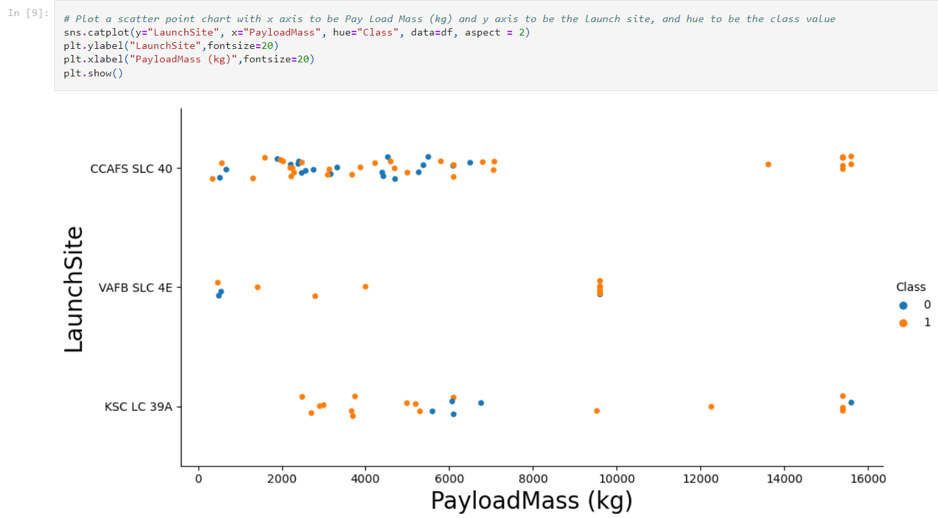
Payload vs. Launch Site
scatter plot of Payload vs. Launch Site is as shown below
no rockets with payload mass greater than 10000 kg were launched from VAFB-SLC
the respective payload of each launch is marked by class-0 (failure) and class-1 (success) accordingly at each launch site

Slide 20
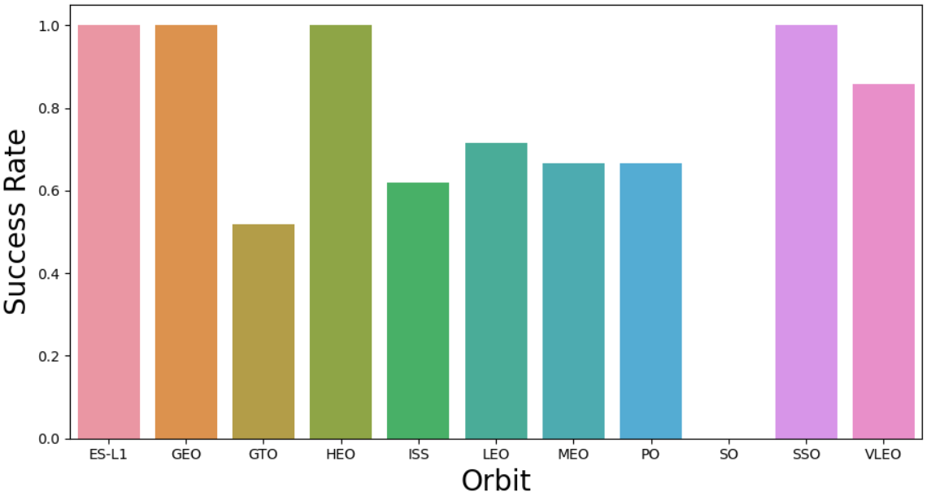
Success Rate vs. Orbit Type
success rate of each orbit type is as shown below
4-orbits of {ES-L1, GEO, HEO and SSO} are of high success rates
the respective payload of each launch is marked by class-0 (failure) and class-1 (success) accordingly at each launch site

Slide 21
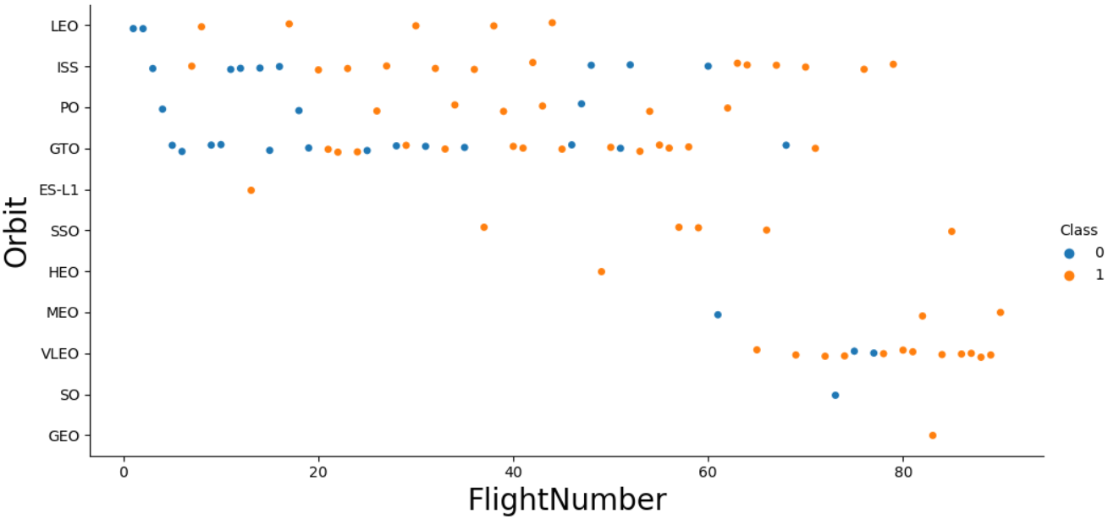
Flight Number vs. Orbit Type
scatter plot of Flight Number vs. Orbit type is as shown below
orbit-LEO appears to have its success-rate related to the number of flights
no relationship between flight number and its success-rate for orbit-GTO

Slide 22
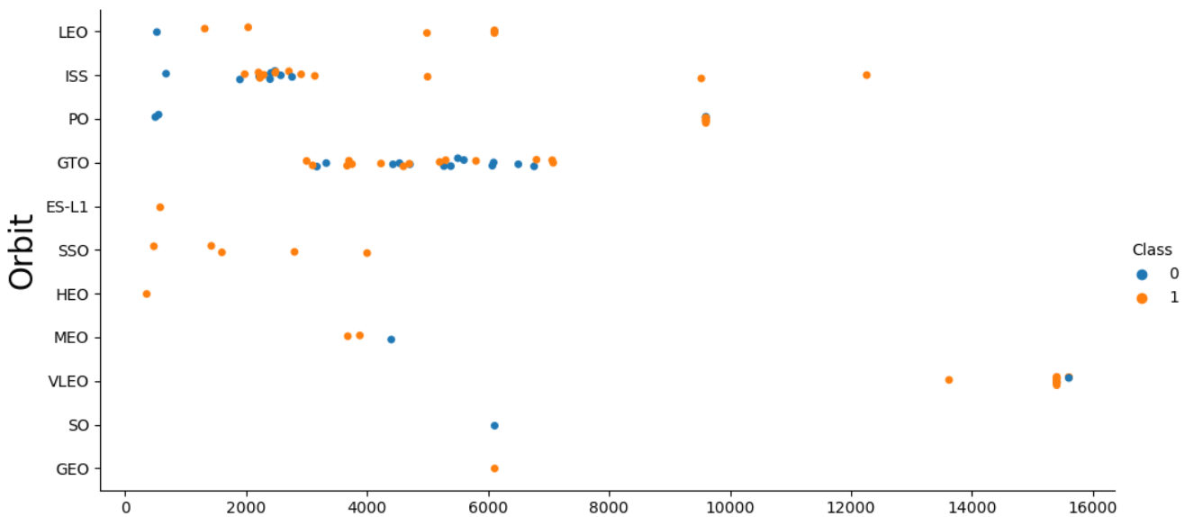
Payload vs. Orbit Type
scatter plot of Payload vs. Orbit type is as shown below
for heavy payloads the successful landing or positive landing rate are more for Polar, LEO and ISS
cannot distinguish positive land negative landing rates for orbit-GTO

Slide 23
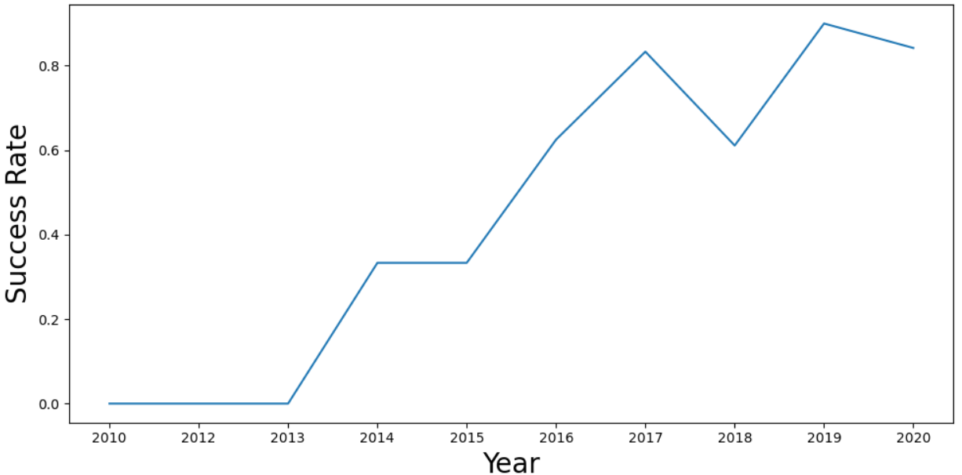
Launch Success Yearly Trend
plot of yearly success rate is as shown below
the success rate kept increasing since 2013

Slide 24
All Launch Site Names
Find the names of the unique launch sites
Present your query result with a short explanation here

Slide 25
Launch Site Names Begin with 'CCA'
Find 5 records where launch sites begin with `CCA`
Present your query result with a short explanation here

Slide 26
Total Payload Mass
Calculate the total payload carried by boosters from NASA
Present your query result with a short explanation here

Slide 27
Average Payload Mass by F9 v1.1
Calculate the average payload mass carried by booster version F9 v1.1
Present your query result with a short explanation here

Slide 28
First Successful Ground Landing Date
Find the dates of the first successful landing outcome on ground pad
Present your query result with a short explanation here

Slide 29
Successful Drone Ship Landing with Payload between 4000 and 6000
List the names of boosters which have successfully landed on drone ship and had payload mass greater than 4000 but less than 6000
Present your query result with a short explanation here

Slide 30
Total Number of Successful and Failure Mission Outcomes
Calculate the total number of successful and failure mission outcomes
Present your query result with a short explanation here

Slide 31
Boosters Carried Maximum Payload
List the names of the booster which have carried the maximum payload mass
Present your query result with a short explanation here

Slide 32
2015 Launch Records
List the failed landing_outcomes in drone ship, their booster versions, and launch site names for in year 2015
Present your query result with a short explanation here

Slide 33
Rank Landing Outcomes Between 2010-06-04 and 2017-03-20
Rank the count of landing outcomes (such as Failure (drone ship) or Success (ground pad)) between the date 2010-06-04 and 2017-03-20, in descending order
Present your query result with a short explanation here

Slide 34

Section 3

Slide 35
<Folium Map Screenshot 1>
Replace <Folium map screenshot 1> title with an appropriate title
Explore the generated folium map and make a proper screenshot to include all launch sites’ location markers on a global map
Explain the important elements and findings on the screenshot

Slide 36
<Folium Map Screenshot 2>
Replace <Folium map screenshot 2> title with an appropriate title
Explore the folium map and make a proper screenshot to show the color-labeled launch outcomes on the map
Explain the important elements and findings on the screenshot

Slide 37
<Folium Map Screenshot 3>
Replace <Folium map screenshot 3> title with an appropriate title
Explore the generated folium map and show the screenshot of a selected launch site to its proximities such as railway, highway, coastline, with distance calculated and displayed
Explain the important elements and findings on the screenshot

Slide 38

Section 4

Slide 39
<Dashboard Screenshot 1>
Replace <Dashboard screenshot 1> title with an appropriate title
Show the screenshot of launch success count for all sites, in a piechart
Explain the important elements and findings on the screenshot

Slide 40
<Dashboard Screenshot 2>
Replace <Dashboard screenshot 2> title with an appropriate title
Show the screenshot of the piechart for the launch site with highest launch success ratio
Explain the important elements and findings on the screenshot

Slide 41
<Dashboard Screenshot 3>
Replace <Dashboard screenshot 3> title with an appropriate title
Show screenshots of Payload vs. Launch Outcome scatter plot for all sites, with different payload selected in the range slider
Explain the important elements and findings on the screenshot, such as which payload range or booster version have the largest success rate, etc.

Slide 42

Section 5

Slide 43
Classification Accuracy
Visualize the built model accuracy for all built classification models, in a bar chart
Find which model has the highest classification accuracy

Slide 44
Confusion Matrix
Show the confusion matrix of the best performing model with an explanation

Slide 45
Conclusions
Point 1
Point 2
Point 3
Point 4
…

Slide 46
Appendix
Include any relevant assets like Python code snippets, SQL queries, charts, Notebook outputs, or data sets that you may have created during this project

Slide 47


